Slide 1
Statistics 367-1-4361 Linear Models
Opher Donchin

Slide 2
5A Review

Slide 3
6A Linear Models

Slide 4
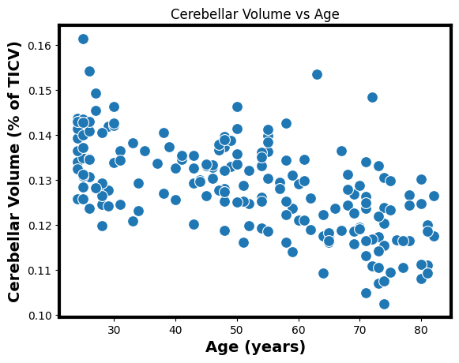
Some bivariate data
x: independent variable
y: dependent variable
Sometimes this makes sense
Age is affecting cerebellar volume
Sometimes it’s arbitrary
Cerebral volume and cerebellar volume

Slide 5
Examples of bivariate data
May be linearly related
Probably not linearly related

Slide 6
The bivariate population model
Like the normal model
Where the mean depends on another variable

Slide 7
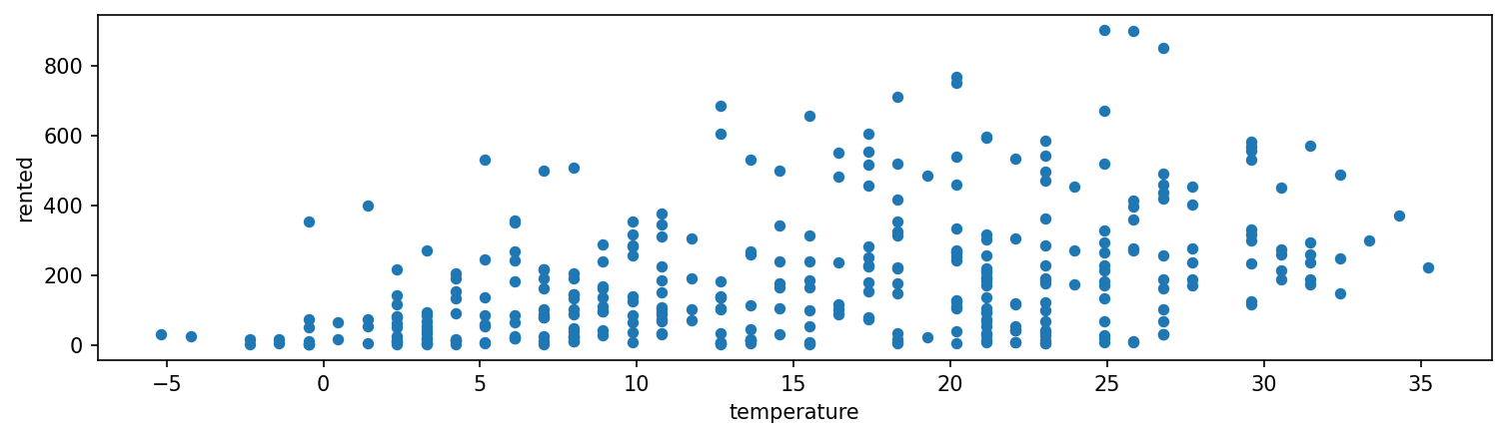
Bike rentals and temperature
Fewer people want to rent bikes when it is below freezing!
Which assumptions hold?

Slide 8
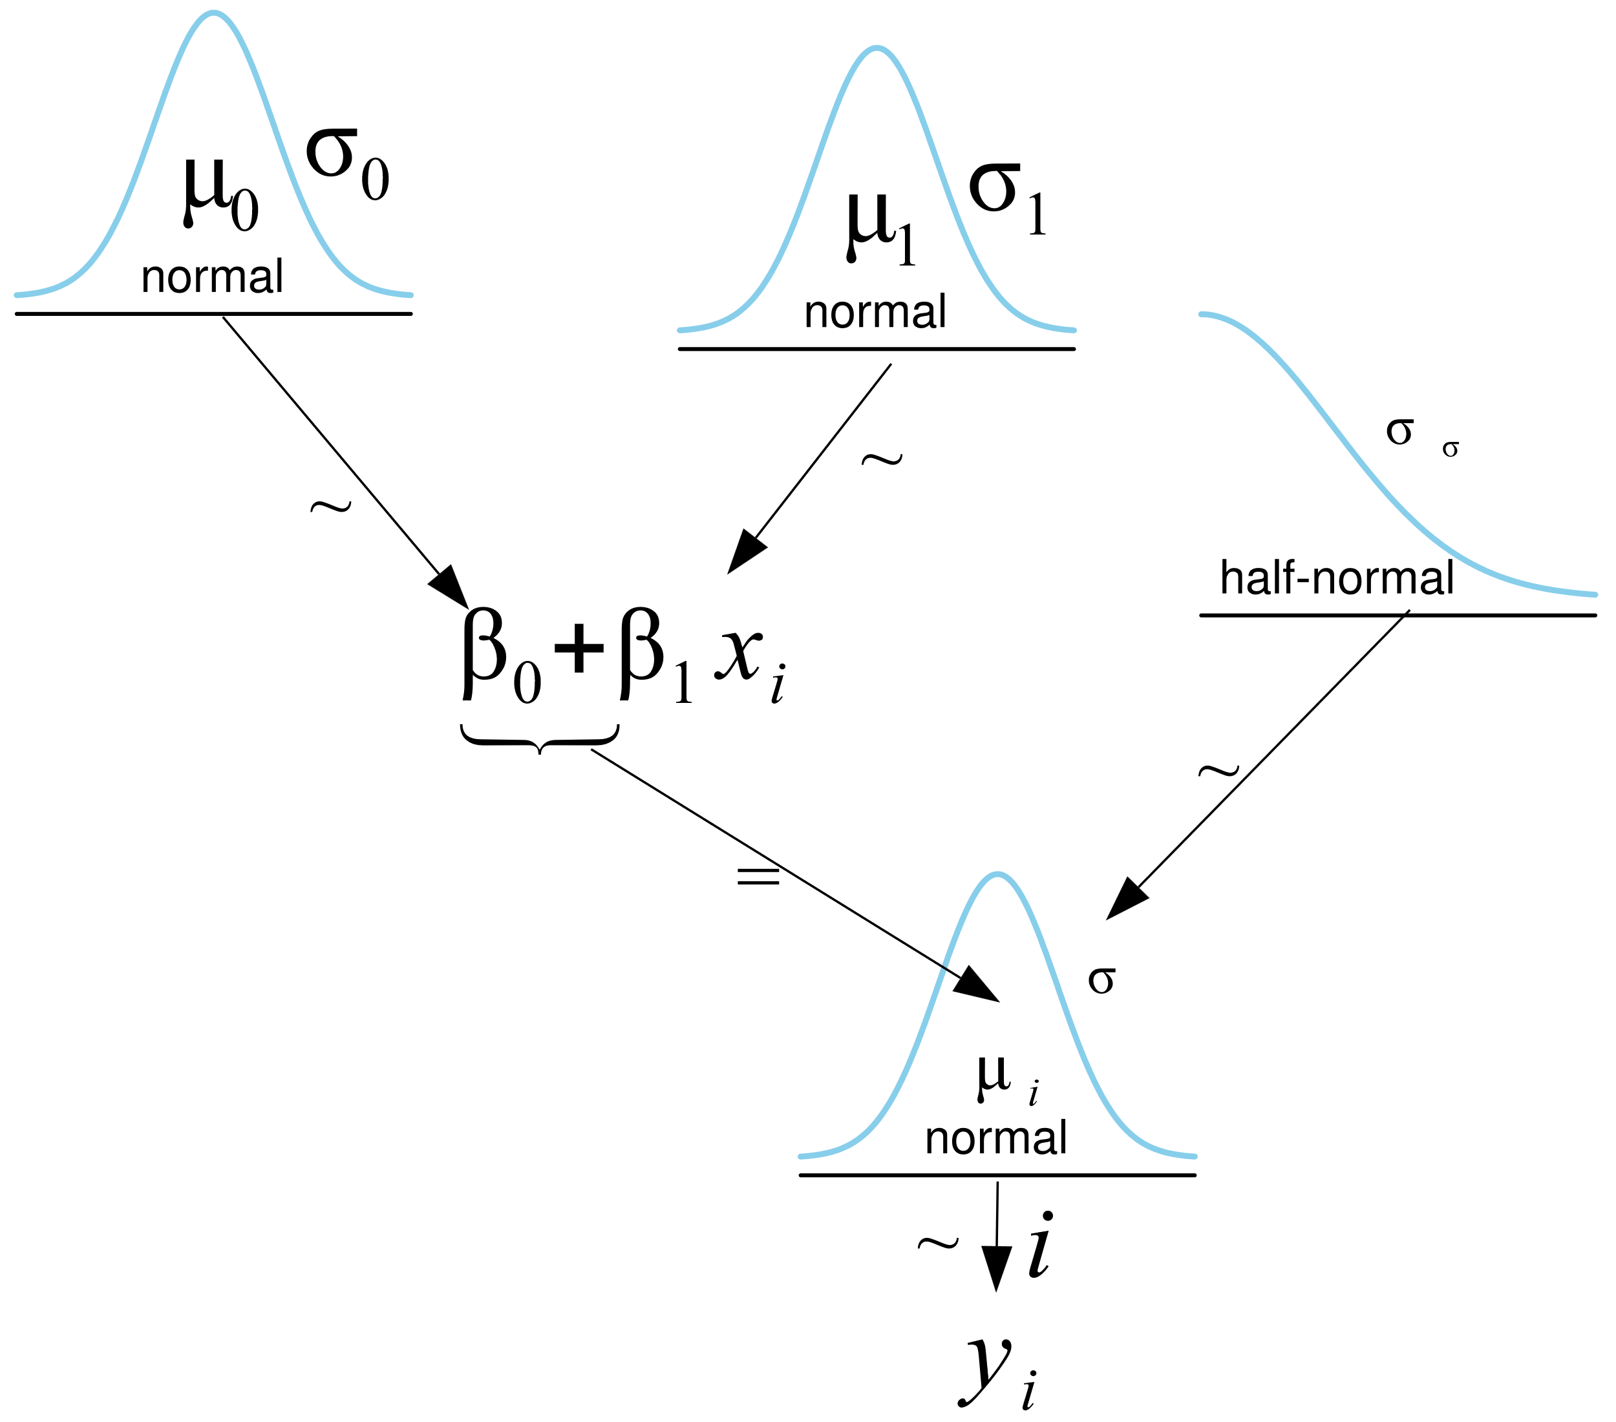
Modeling the bike data
coords = {"data": np.arange(len(bikes))}
with pm.Model(coords=coords) as model_lb:
β0 = pm.Normal("β0", mu=0, sigma=100)
β1 = pm.Normal("β1", mu=0, sigma=10)
σ = pm.HalfNormal("σ", 10)
μ = pm.Deterministic("μ", β0 + β1 * bikes.temperature, dims="data")
y_pred = pm.Normal("y_pred", mu=μ, sigma=σ, observed=bikes.rented, dims="data")
)
Using a deterministic variable

Slide 9
Deterministic variables in PyMC
Deterministic variables
Get a new value at each MCMC sample
Can have both inputs and outputs
Are in the PyTensor graph
Are sampled in the posterior of the InferenceData object
This is what declaring the variable does
With a declared deterministic variable
μ = pm.Deterministic("μ", β0 + β1 * bikes.temperature)
y_pred = pm.Normal("y_pred", mu=μ, sigma=σ, observed=bikes.rented)
Without a declared deterministic variable
μ = β0 + β1 * bikes.temperature
y_pred = pm.Normal("y_pred", mu=μ, sigma=σ, observed=bikes.rented)

Slide 10
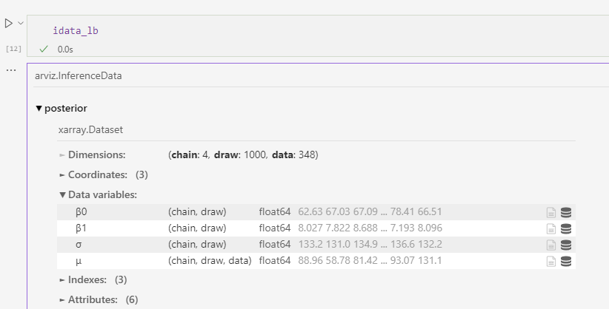
The deterministic variable in the idata
This can be a large object
Which can be recalculated if necessary

Slide 11
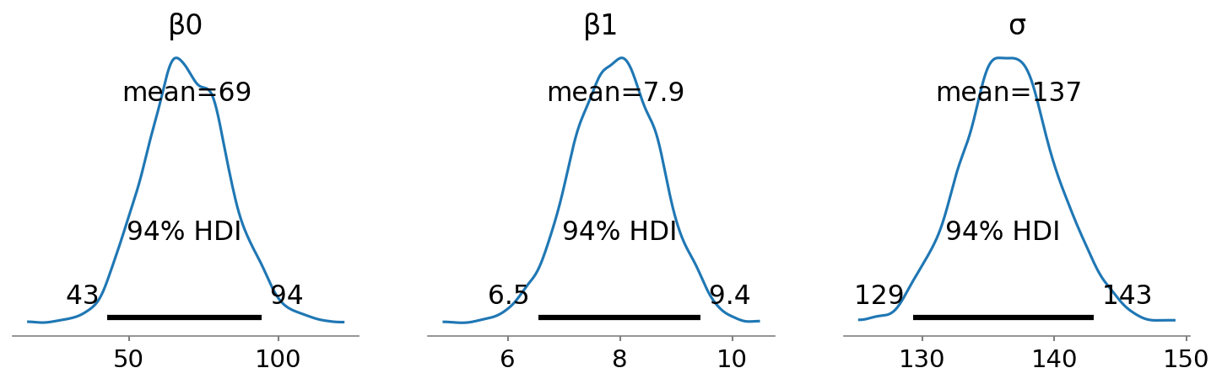
Posteriors converge to something
But also:
This is a prediction about the number of bikes rented at each temperature
That includes uncertainty

